Slide 1
Magento 2 Development and Best Practices – Setup Developer Environment
Suman Kar | Technical Architect

Slide 2
Overview
Setup Developer Environment
Setup PSR coding standards
Setup Magento Coding Standards
Utilization of Code Inspector
Inspect Deprecated Code
Setup different server components
Setup Xdebug
Setup Local Email Sever
Setup EQP-MT and use case commands
SonarCube installation and execution commands
Q/A

Slide 3
Setup Developer Environment
The environment can be setup using any dedicated or virtual box set up
Docker
Vagrant
Oracle Virtual Box
Windows Linux subsystem – WSL
Developer can use their own preference with Linux based operating system
Linux distributors such as CentOS, Ubuntu, Debian or RedHat Enterprise Linux

Slide 4
Building The Technology Stack (MANDATORY)
Ability to switch multiple PHP and PHP-FPM version
Magento mandatory PHP extensions
Nginx as Application Server
Composer Latest version
JRE (Java Run time environment)
GIT as version manager
Redis, Varnish, RabbitMQ, Elasticsearch as service running in the environment
Magento Cloud Command(magentod-cloud)
Ability to install multiple service components and 3rd party application
Ability to install multiple MYSQL version like Mysql Core, MariaDB , Percona
Ability to take backup easily
Reference URL : https://devdocs.magento.com/guides/v2.4/install-gde/system-requirements.html

Slide 5
PHP – Additional Extension (MANDATORY)
Opcache
We strongly recommend you verify that PHP OPcache is enabled for performance reasons. The OPcache is enabled in many PHP distributions. To verify if it is installed, see our PHP documentation.
opcache.enable=1
opcache.memory_consumption=128
opcache.interned_strings_buffer=8
opcache.max_accelerated_files=4000
opcache.revalidate_freq=60
opcache.fast_shutdown=1
opcache.enable_cli=1

Slide 6
PHP – Additional Extension (MANDATORY)
xdebug
Will be used for code debug
zend_extension=xdebug.so
xdebug.remote_enable=true
xdebug.remote_host=10.0.75.1 //host IP address/Main windows IP address
xdebug.remote_port=9005
xdebug.remote_autostart=1
xdebug.idekey=PHPSTORM

Slide 7
PHP – Additional Extension (MANDATORY)
Action Item for developer :
Make sure the developer environment Opcache is enabled and working properly
Action Item for cloud project :
Make sure the Opcache is enabled in QA instance and Production instance

Slide 8
PWA – Additional Components
Python 2.7
Node.js
Yarn
NVM
NPM

Slide 9
Selection of PHP IDE/Code Editor (MANDATORY)
Recommended PhpStorm
NetBeans can be used as alternate for time being
For light weight editor Visual Code Studio, Notepad++ can be used

Slide 10
Setup PSR coding standards – PhpStorm (MANDATORY)
Setup PSR 14 as coding standard
If using older version of PhpStorm PSR 2 also will work

Slide 11
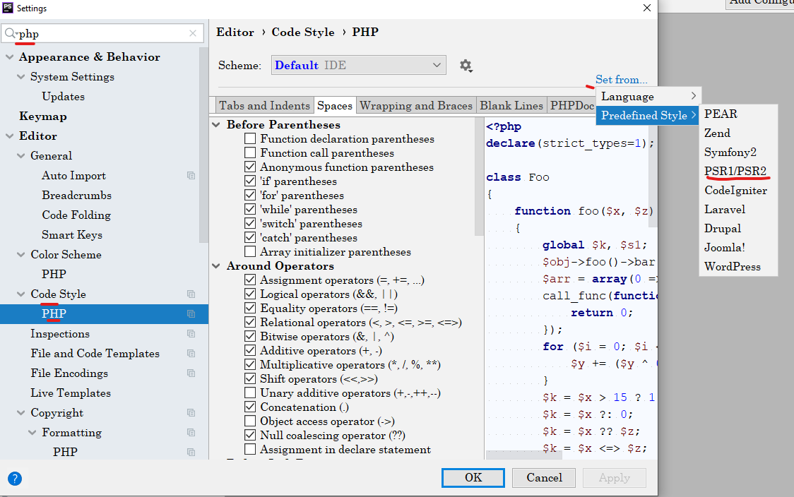
Setup PSR coding standards – PhpStorm (MANDATORY)
Open the project
Settings → Search PHP
Under Code Style → Click on PHP
From the right corner Select Predefined Style → Select PSR 1/ PSR2 or PSR14

Slide 12
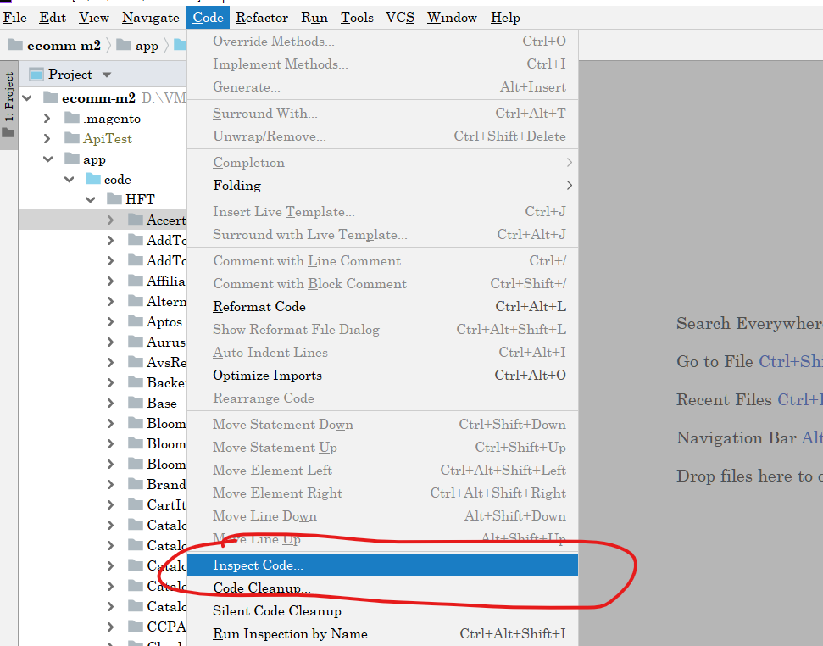
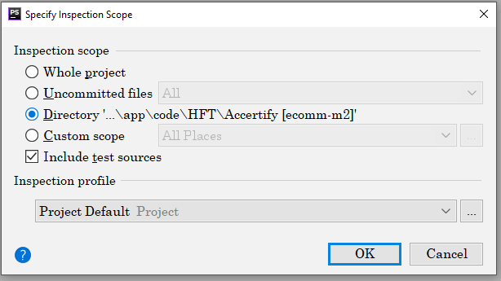
Utilization of Code Inspector – PhpStorm (MANDATORY)

Slide 13
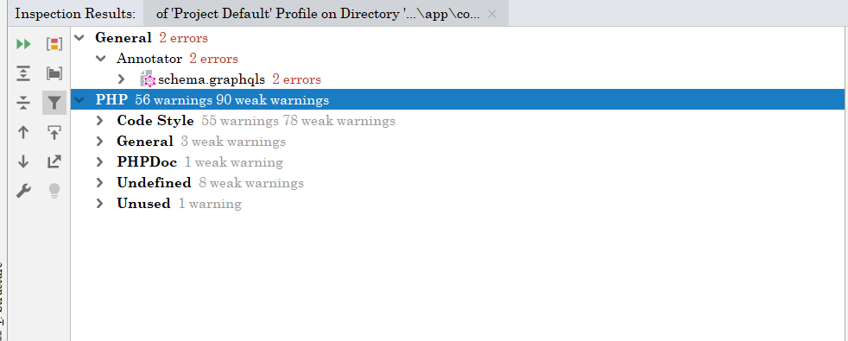
Utilization of Code Inspector – PhpStorm (MANDATORY)

Slide 14
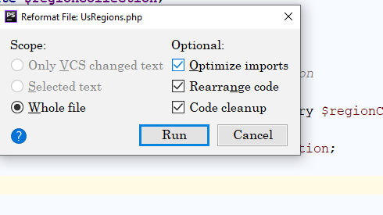
PhpStorm Auto Correction (MANDATORY)
Auto correction is great feature which can be used to refactor and correct the file as per the the coding standards
Tigger Auto correction
Open any file
Press shift + ctrl+ alt + L

Slide 15
Setup Magento Coding Standards (MANDATORY)
Source Link : https://github.com/magento/magento-coding-standard
Action Item for developer :
Before committing any code in Git, dev should run the tool in his local, fix the identified bugs and commit the code.
If any issue that is found by scanner and dev is not able to fix that, it is dev responsibility to highlight that to Arch and find the alternate solution.
Action items for the Project Architect or the senior dev who has code merge authority:
Project Architect should run the Magento coding standard scanner before any major release and address the issues identified by the code scanner.

Slide 16
Setup Magento coding standards – PhpStorm
You can setup Magento coding standards in PhpStorm
Tutorial :
https://mirasvit.com/blog/guide-for-setting-up-phpstorm-for-magento-2-developments.html
https://www.atwix.com/magento-2/configure-code-sniffer-for-phpstorm/

Slide 17
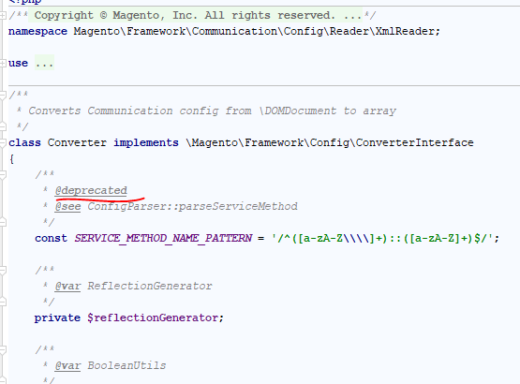
How to find Deprecated Code (MANDATORY)

Slide 18
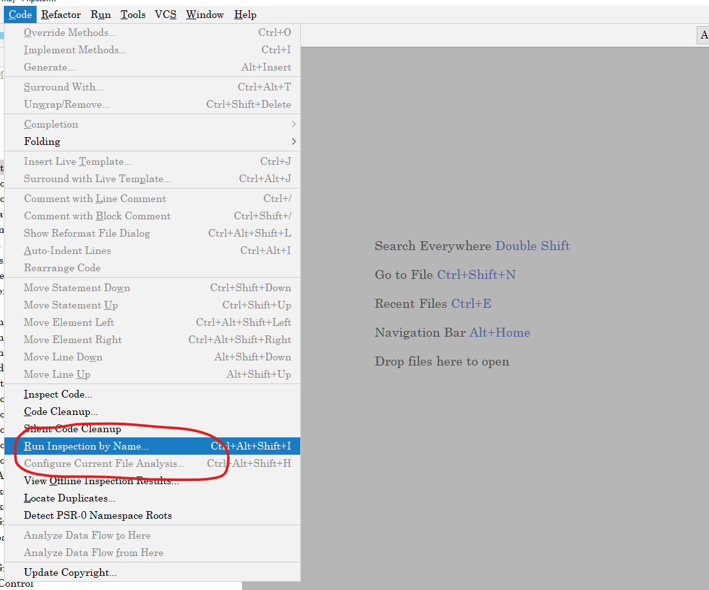
Inspector Deprecated Code (MANDATORY)

Slide 19
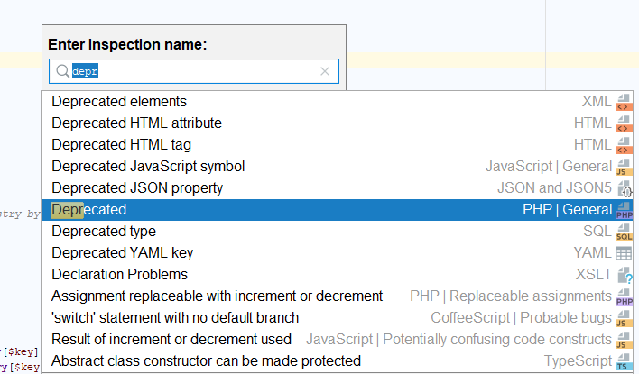
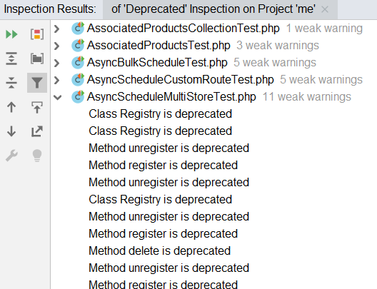
Find Deprecated Code in PHPStorm (MANDATORY)
Run Deprecated Inspection
Result

Slide 20
Find Deprecated Code in PHPStorm (MANDATORY)
Action Item for developer :
Before committing any code in Git, dev should run the deprecated scan in his local, fix the identified bugs and commit the code.
If any issue that is found by scanner and dev is not able to fix that, it is dev responsibility to highlight that to Arch and find the alternate solution.
Action items for the Project Architect or the senior dev who has code merge authority:
Project Architect should run the deprecated scanner before any major release and address the issues identified by the code scanner.

Slide 21
Setup Xdebug with PhpStorm (MANDATORY)
Action Item for developer :
Dev must setup Xdebug in his local with PhpStorm and use the debugging functionality.
Dev must understand how to use the Xdebug feature
Execute the current code and go to the next line, press
Go into the current method, press
Step out, press
Stop debugging, continue the code flow, press
Stop the code flow and then terminate the debug, press
Tutorial :
https://devdocs.magento.com/cloud/howtos/debug.html
https://magenest.com/en/debug-magento-2-xdebug-phpstorm-part-2/
https://stackoverflow.com/questions/45268563/phpstorm-xdebug-virtualbox
https://www.pascallandau.com/blog/setup-phpstorm-with-xdebug-on-docker/

Slide 22
Local Email Server Setup (MANDATORY)
For local email server mailhog or mailcatcher can be used
Mailhog :
https://github.com/mailhog/MailHog
https://makandracards.com/vasan/382056-how-to-use-mailhog-in-magento-2-development-with-docker
Mailcatcher :
https://mailcatcher.me/
Action Item for developer :
Developer must setup email server in local
All the feature those have email functionality dev should test them in local first
Necessary email templates and the email output need to be tested in local
Dev should not commit the code with out testing the email functionality

Slide 23
Validating the code with Redis, Varnish, RabbitMQ, Elasticsearch (MANDATORY)
Action Item for developer :
It is mandatory for the developer to test his code in local environment before committing code
Code needs to be validated with Redis, Varnish with full page cache enable
Any custom code which has business logic which involves cache
Any custom code has cache functionality, customer session, cart session
Any frontend feature which involves FPC cache, cache invalidation, TTL etc.
Code needs to be validated with RabbitMQ
Any custom fracture which involves functionality related to queue

Slide 24
Validate your API using Postman (Good to Have)
Postman is a great tool to test API
It has an extensive number of feature to test API
REST/GraphQL can be easily tested in Postman
There are multiple API test clients are available, but Postman is most powerful

Slide 25
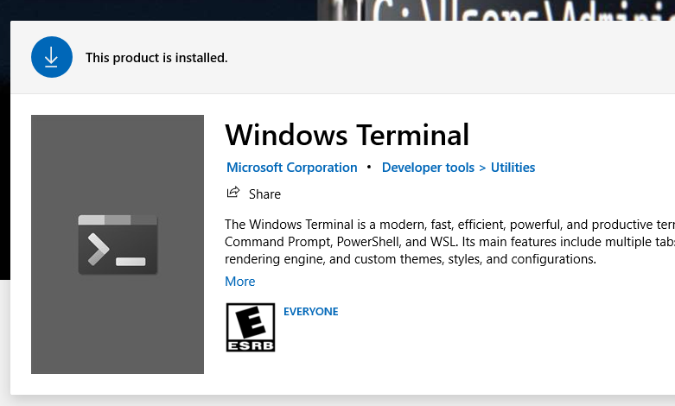
CLI tool (Good to Have)
Windows Terminal is a great tool for ssh, cli and execute any command in through command line

Slide 26
Accessing Database (Good to Have)
There are number of client available to access MYSQL db.
The best tool which has most of the feature is Mysql Workbench

Slide 27
Setup EQP-MT and use case commands (Good to Have)
EQP-MT is developed by Magento service team
This tool provide us several useful feature
This tool can be very useful for code review estimation, code quality check, code upgrade estimation
URL : https://github.com/Magento-ECG-Team/eqp-mt

Slide 28
SonarQube installation and execution commands
Install SonarQube
Install Sonar Scanner
Scan the custom code using Sonar Scanner
Generate the repost in SonarQube interface
SonarQube is a great tool to identify security, encryption related issues in code
Tutorial:
https://www.sonarqube.org/
https://www.c-sharpcorner.com/article/step-by-step-sonarqube-setup-and-run-sonarqube-scanner/

Slide 29
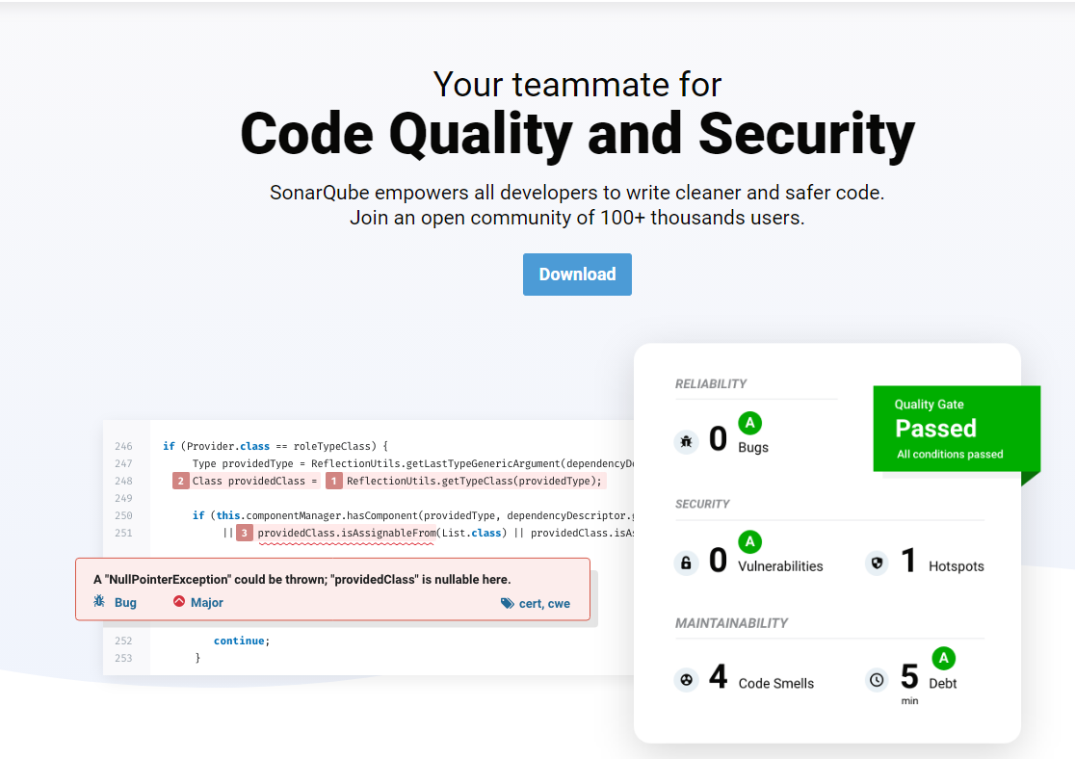
SonarQube and Sonar Scanner

Slide 30
Q/A

Slide 31
Assignment 1
Setup Development environment
Install php 7.4 and 8.1
Local Setup Magento 2.4.3
Additional components need to be installed – composer, local email, elseticsearch, Redis, RabbitMQ
Setup Magento project in PhpStorm with PSR coding standard
Setup Xdebug with PhpStorm

